Slide 1


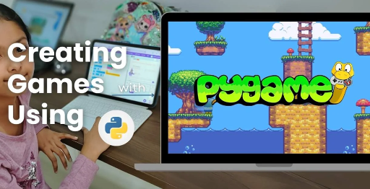
Session 6
Launch Physics & Trajectory

Slide 2
Learning Objectives
Understand the Simulate physics using math: velocity, angle, gravity
👉 Overview of Launch Physics & Trajectory
Detailed Objectives:
Simulate physics for bird launching (velocity, angle, gravity) using the math module.
Implement drag-and-release mechanics for launching birds.
Visualize the bird’s trajectory arc to aid aiming.

Slide 3
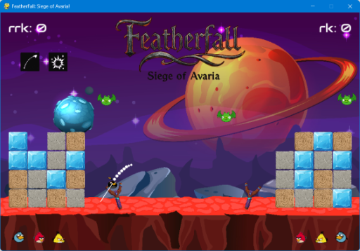
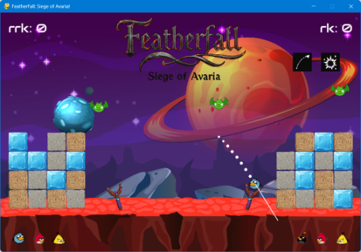
Learning Objectives
👉 Overview of Launch Physics & Trajectory

Slide 4
Practical Tasks
Understand the Simulate physics using math: velocity, angle, gravity
👉 Overview of Launch Physics & Trajectory
Practical Tasks:
Update the Bird class in classes.py with a simulate() method to calculate movement under gravity.
Add mouse drag-and-release input in main.py to set initial velocity based on drag distance and angle.
Write a trajectory visualization function in tools.py to draw a dotted arc predicting the bird’s path.
Test launching a bird and displaying its trajectory.

Slide 5
Deliverables
Understand the Simulate physics using math: velocity, angle, gravity
👉 Overview of Launch Physics & Trajectory
Session Deliverables:
A working bird launch system with trajectory visualization.
Updated classes.py and tools.py with physics and visualization code.
Tips:
Experiment with different gravity values to see how they affect the arc.
Watch a slow-motion Angry Birds video to understand trajectories.

Slide 6
Launch Physics & Trajectory in PyGame
“Designing Bird Launch Mechanics with Python & Math” Introduce the game mechanic and its real-world physics connection.
Understand the Simulate physics using math: velocity, angle, gravity
👉 Designing Bird Launch Mechanics with Python & Math
OMOGAME: Siege of Avaria! introduces a physics-based bird launching mechanic that forms the core of its gameplay experience.
The game is inspired by real-world projectile motion, allowing players to launch birds at fortress structures using intuitive drag-and-release controls.
This mechanic directly connects mathematical concepts and physics principles to interactive gameplay, making learning engaging and hands-on.
The implementation leverages Python and the PyGame-CE library to simulate realistic motion and collisions.
By integrating physics into game design, OMOGAME offers a skill-based challenge that is both educational and entertaining.

Slide 7
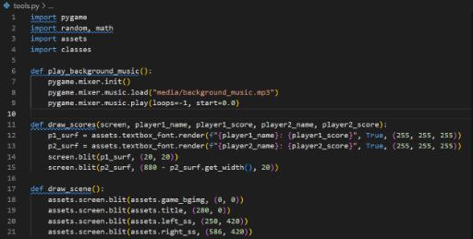
Launch Physics & Trajectory in PyGame
CODE SNIPPET:

Slide 8
What is Physics-Based Launching?
Understand the Simulate physics using math: velocity, angle, gravity
👉 Overview of Launch Physics & Trajectory
Inspired by Angry Birds
Launching birds using drag, angle, velocity
Outcome = calculated movement under gravity 📌 Connects math, physics, and gameplay
Physics-based launching in OMOGAME draws inspiration from the popular Angry Birds game, where players control the trajectory of projectiles.
Players initiate a launch by dragging the bird, which sets both the angle and the velocity of the shot based on the drag vector.
Once released, the bird’s movement is calculated in real-time, simulating the effects of gravity and initial force.
The outcome of each launch is determined by the calculated movement under gravity, resulting in a realistic parabolic path.
This mechanic bridges the gap between mathematical modeling, physics simulation, and interactive gameplay, making it ideal for educational purposes.

Slide 9
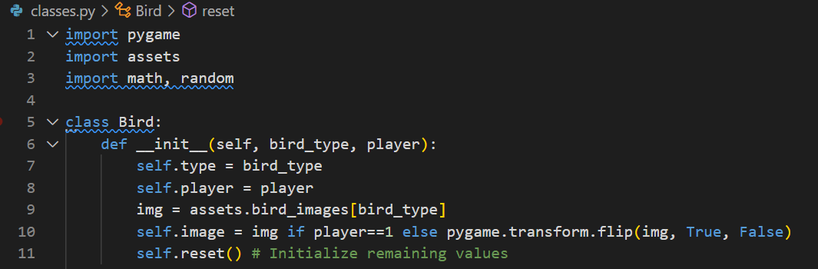
What is Physics-Based Launching?
CODE SNIPPET :

Slide 10
Key Physics Concepts
Understand the Simulate physics using math: velocity, angle, gravity
👉 Overview of Launch Physics & Trajectory
Initial Velocity
Angle of Release
Gravity (acceleration down)
Trajectory Prediction 📐 Use of math.sin, math.cos, and time steps
The initial velocity of the bird is determined by the distance and direction of the drag, which translates user input into game physics.
The angle of release is calculated using vector mathematics, ensuring that each launch accurately reflects the player’s intended direction.
Gravity acts as a constant downward acceleration, influencing the arc and eventual landing point of the bird.
Trajectory prediction is achieved using trigonometric functions and discrete time steps, allowing the game to simulate motion frame by frame.
Functions such as math.sin, math.cos, and time-based calculations are essential for updating the bird’s position throughout its flight.

Slide 11
The Bird Class – Add simulate() Method
Understand the Simulate physics using math: velocity, angle, gravity
👉 Overview of Launch Physics & Trajectory
Add a method in classes.py:
# Update position using velocity and gravity
Simulates arc based on input drag and time
The Bird class, defined in classes.py, encapsulates the properties and behaviors of each bird in the game.
To simulate realistic projectile motion, a simulate(self, t) method is added to the Bird class, updating its position based on velocity and gravity.
This method calculates the bird’s new coordinates at each time step, applying the fundamental equations of motion.
The implementation ensures that the bird follows a smooth arc, reflecting both the initial launch parameters and the ongoing influence of gravity.
By modeling the bird’s flight path mathematically, the game achieves a high degree of realism and predictability in its launch mechanics.

Slide 12
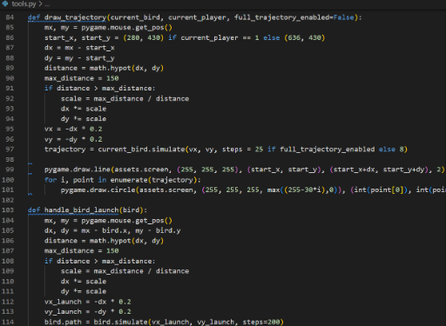
The Bird Class – Add simulate() Method
CODE SNIPPET:

Slide 13
Handling Mouse Drag-and-Release
Understand the Simulate physics using math: velocity, angle, gravity
👉 Overview of Launch Physics & Trajectory
Implement in main.py:
On mouse down: record start position
On mouse up: calculate velocity & angle
Launch the bird 💡 Use vector math to determine direction & speed
The drag-and-release mechanic is implemented in main.py, where user input is captured to determine the launch parameters.
When the player presses the mouse button down, the game records the starting position of the drag, establishing the origin point for the launch.
Upon releasing the mouse button, the game calculates the drag vector, which is then used to set the bird’s initial velocity and angle of release.
The bird is launched by passing these calculated parameters to its physics simulation, initiating its flight across the game screen.
Vector mathematics is used to translate the player’s drag gesture into precise direction and speed values for the launch.

Slide 14
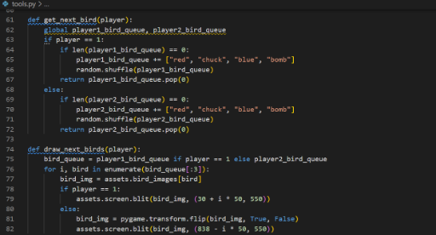
Handling Mouse Drag-and-Release
CODE SNIPPET :

Slide 15
Drawing the Trajectory Arc
Understand the Simulate physics using math: velocity, angle, gravity
👉 Overview of Launch Physics & Trajectory
Add function in tools.py
Visual: dotted line showing future path
Use frame prediction to plot arc points 🧪 Helps players aim before releasing
The predicted trajectory arc is visualized in tools.py, providing players with a visual guide for aiming their shots.
A dedicated function plots a dotted line or a series of points along the predicted path, using the same physics calculations as the actual launch.
This visualization is generated by predicting the bird’s position at multiple future time steps, effectively simulating its flight in advance.
By displaying the trajectory arc, the game helps players understand the relationship between their input and the resulting motion.
This feature enhances both gameplay feedback and player skill development, making the experience more interactive and educational.

Slide 16
Drawing the Trajectory Arc
CODE SNIPPET:

Slide 17
Student Exercise: Try It Yourself – Code & Test
Understand the Simulate physics using math: velocity, angle, gravity
👉 Overview of Launch Physics & Trajectory
🧰 Task:
Update simulate() in Bird
Enable drag-and-launch in main.py
Visualize path in tools.py ✅ Outcome: One bird flies with correct physics + arc shown
Students are encouraged to implement and test the complete launch physics pipeline, reinforcing their understanding through hands-on practice.
The first step is to update the simulate() method in the Bird class to ensure accurate motion under gravity and initial velocity.
Next, students should enable drag-and-launch input handling in main.py, allowing for interactive control of the bird’s flight.
Visualizing the predicted arc in tools.py provides immediate feedback and helps debug the implementation.
The goal is to achieve a scenario where a bird flies with correct physics, and its trajectory is accurately displayed before launch.

Slide 18
Student Experiment: Change Gravity!
Understand the Simulate physics using math: velocity, angle, gravity
👉 Overview of Launch Physics & Trajectory
Let students try:
self.gravity = 0.5 vs. .2 vs. .0
Observe how arc flattens or steepens 🎓 Add critical thinking: “Why does the bird fall faster?”
Students can experiment by modifying the gravity constant in the Bird class, observing how different values affect the bird’s trajectory.
For example, setting self.gravity = 0.5, .2, or .0 will produce noticeably different arcs, from flatter to steeper paths.
This exercise demonstrates the direct impact of gravity on projectile motion, reinforcing key physics concepts in a visual way.
Students are encouraged to think critically about why the bird falls faster or slower with different gravity settings, linking game mechanics to real-world science1.
Such experimentation fosters a deeper understanding of both coding and physics, making the learning process engaging and inquiry-driven.

Slide 19
Why Physics Makes Games Fun
Understand the Simulate physics using math: velocity, angle, gravity
👉 Overview of Launch Physics & Trajectory
Predictable rules → rewarding gameplay
Adds realism and skill-based challenge 📚 Link to real-world Newtonian motion
Implementing predictable physics rules creates a rewarding and skill-based gameplay experience, where players can learn and improve over time.
Realistic motion adds depth and challenge to each launch, requiring players to master timing, angle, and power for successful shots.
The use of physics in games like OMOGAME connects directly to Newtonian motion, illustrating concepts such as velocity, acceleration, and parabolic arcs.
By linking gameplay to real-world science, the game makes learning both fun and relevant for students.
This approach demonstrates how mathematics and physics can be applied creatively in technology and entertainment.

Slide 20
Recap & Project Extension
Understand the Simulate physics using math: velocity, angle, gravity
👉 Overview of Launch Physics & Trajectory
✅ You implemented: drag logic, simulate(), and arc drawing
Deliverables: working launcher + updated files 🎯 Challenge: Add wind resistance OR bounce on ground!
In this session, you have implemented mouse drag logic for launch input, enabling interactive control over the bird’s flight.
You have developed the simulate() method to model realistic bird motion, applying physics equations in your code.
The trajectory arc drawing feature provides players with valuable aiming feedback, enhancing both gameplay and learning.
As a next step, you can add new bird types with unique physics properties or experiment with game features like wind or power-ups that affect trajectory.
Extending your project to include custom levels or new mechanics will further deepen your understanding of both PyGame and physics-based game development.

Slide 21

Exercise:
1. What is the primary objective of the Quick Mode in OMOGAME?
A) Collect all power-ups before the opponent
B) Launch birds without any destruction
C) Reach a score of 200 points
D) Complete the entire storyline
Answer: C) Reach a score of 200 points
2. Which file is considered the main entry point of the OMOGAME project? A) tools.py
B) main.py
C) assets.py
D) classes.py
Answer: B) main.py

Slide 22
Exercise..
3. What does the tools.py file mainly handle in the game?
A) Launching sound and animation
B) Player avatar selection
C) Collision detection and drawing functions
D) Managing game instructions
Answer: C) Collision detection and drawing functions
4. Which of the following is NOT listed as a unique feature of OMOGAME? A) Bird classes with special physics
B) Alien targets for bonus points
C) Multiplayer online matchmaking
D) Destructible block environments
Answer: C) Multiplayer online matchmaking

Slide 23
Exercise…
5. Why is organizing the OMOGAME project into files like classes.py, media/, and game_modes.py important?
A) It reduces the game’s memory usage
B) It helps reduce the number of bugs completely
C) It makes the project look colorful
D) It simplifies managing and updating different game parts
Answer: D) It simplifies managing and updating different game parts

Slide 24
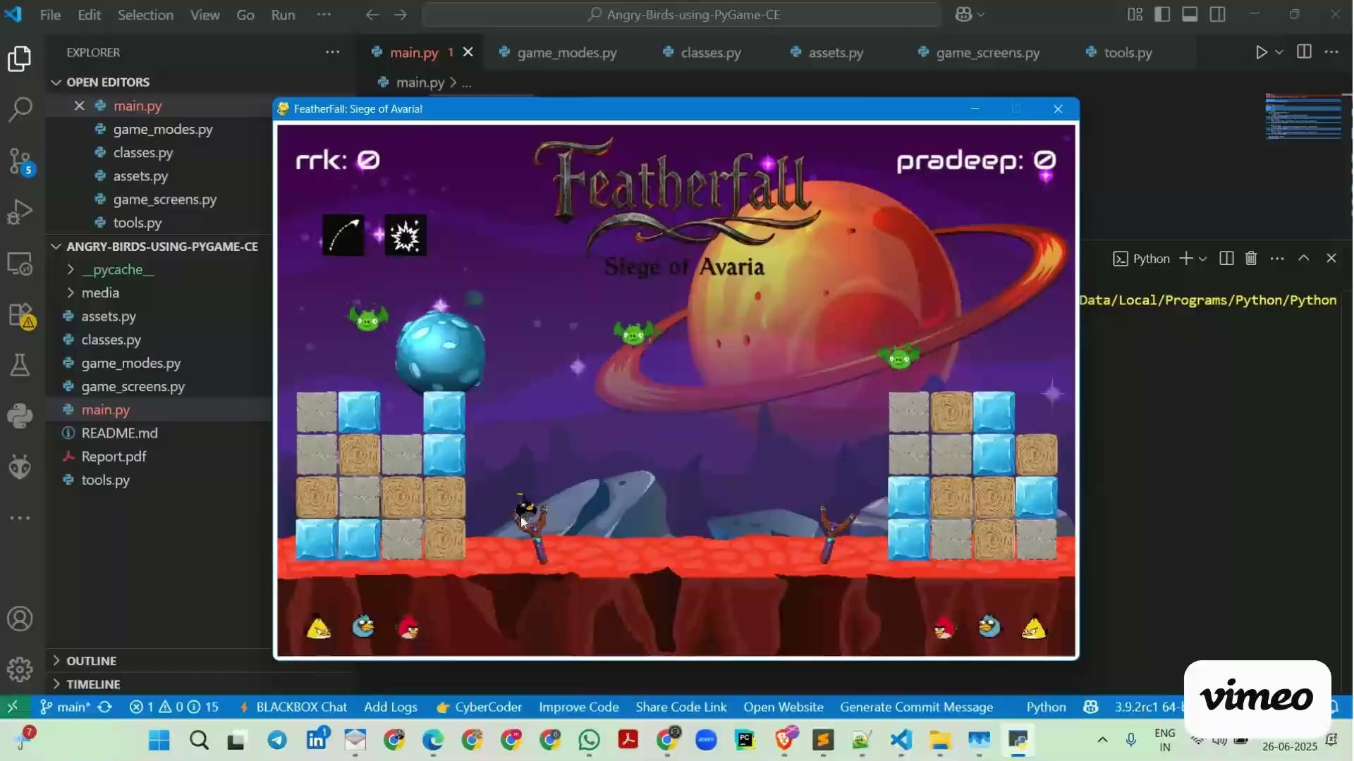
Session 6 VIDEO LINK
Launch Physics & Trajectory

